Slide 1
Weather and Traffic Accident Analysis in Vancouver Using Open Data and Data Science Tools
Exploring data-driven insights for urban safety improvements
Jonathan Wong
Notes:
AI-generated content may be incorrect. --- This presentation explores the relationship between weather conditions and traffic accidents in Vancouver using open data and advanced data science tools. We will walk through the study's background, data sources, analytical methods, and key findings to provide insightful conclusions for city planning and safety improvements.

Slide 2

Presentation Agenda
Introduction to Weather and Traffic Accident Analysis in Vancouver
Data Sources and Analytical Tools
Data Cleaning and Preparation
Exploratory Data Analysis (EDA)
Visualizing Key Trends in Weather and Traffic Accidents
Train/Test Split and Machine Learning Modeling
Insights and Conclusions From the Analysis
Notes:
--- We will begin with an introduction to the study's background and objectives, followed by an overview of data sources and tools used. Next, we will cover data cleaning and exploratory analysis, visualization of key trends, machine learning modeling, and conclude with insights and implications. Image source: Microsoft 365 content library

Slide 3
Introduction to Weather and Traffic Accident Analysis in Vancouver
Notes:
This section introduces the importance of analyzing the interplay between weather and traffic accidents in Vancouver, outlining the study's main goals and providing context about the city's traffic and weather patterns.

Slide 4

Background and Importance of the Study
Impact of Weather on Traffic
Weather conditions significantly influence the frequency and severity of traffic accidents in urban areas.
Importance for Road Safety
Studying weather impacts helps improve road safety measures and reduce accident risks effectively.
Role of Open Data Analysis
Leveraging open data enables detailed analysis of weather and traffic accident patterns in Vancouver.
Context of Vancouver
Vancouver’s diverse weather and traffic dynamics provide a crucial context for studying accident impacts.
Notes:
--- Understanding how weather impacts traffic accidents is crucial for improving road safety and informing city planning. This study leverages open data to analyze these relationships specifically in Vancouver, where diverse weather conditions and traffic dynamics exist. Image source: Microsoft 365 content library

Slide 5

Objectives of the Analysis
Identify Weather Factors
Analyze key weather variables that influence accident rates to understand their impact effectively.
Evaluate Data Patterns
Examine data-driven patterns to uncover trends and correlations related to accidents in Vancouver.
Build Predictive Models
Develop predictive models to support decision-making and improve public safety strategies.
Notes:
--- The analysis aims to identify key weather factors influencing accident rates, evaluate data-driven patterns, and build predictive models to support decision-making and enhance public safety strategies in Vancouver. Image source: Microsoft 365 content library

Slide 6

Overview of Vancouver’s Traffic and Weather Context
Variable Weather Impact
Vancouver's rain and mild temperatures significantly influence traffic flow and safety on the roads.
Understanding how weather conditions impact traffic patterns helps improve safety and flow management in Vancouver.
Notes:
--- Vancouver experiences variable weather including rain and mild temperatures, which affect traffic flow and accident occurrence. The city’s traffic infrastructure and patterns set the stage for the analysis of these interactions. Image source: Microsoft 365 content library

Slide 7
Data Sources and Analytical Tools
Notes:
This section details the data used and the tools employed for the analysis, highlighting the integration of city data, weather statistics, and programming resources.

Slide 8

City of Vancouver Strategic Plan Dashboard
Source of Data
Traffic accident data is sourced from the City of Vancouver’s Strategic Plan Dashboard for reliability and accuracy.
The dashboard provides detailed and regularly updated records essential for comprehensive traffic analysis.
Sources:
https://city-of-vancouver-strategic-plan-dashboard-cityofvancouver.hub.arcgis.com/datasets/collisions/explore
Notes:
--- Traffic accident data was sourced from the City of Vancouver’s Strategic Plan Dashboard, providing detailed and updated records essential for accurate analysis. Image source: Microsoft 365 content library

Slide 9

Weatherstats.ca Sourced From Environment and Climate Change Canada
Reliable Weather Data Source
Weatherstats.ca aggregates data from Environment and Climate Change Canada for accurate meteorological information.
The data encompasses a wide range of weather variables ensuring thorough climate analysis.
Sources:
https://vancouver.weatherstats.ca/download.html
Notes:
--- Weather data was obtained from Weatherstats.ca, which compiles information from Environment and Climate Change Canada, ensuring reliable and comprehensive meteorological inputs. Image source: Microsoft 365 content library

Slide 10

Utilizing Google Colab, Python Pandas, Matplotlib, and Bokeh
Cloud Computing with Google Colab
Google Colab provides cloud computing resources that facilitate accessible and efficient data analysis workflows.
Data Manipulation with Pandas
Pandas library is used for efficient and flexible data manipulation and cleaning in Python.
Static Visualization with Matplotlib
Matplotlib enables creation of detailed static plots to visualize data trends and insights clearly.
Interactive Visualization with Bokeh
Bokeh provides tools for interactive and dynamic data visualizations to explore datasets thoroughly.
Notes:
--- Data analysis and visualization were conducted using Google Colab for cloud computing, Python’s Pandas for data manipulation, Matplotlib for static plots, and Bokeh for interactive visualizations, enabling thorough exploration of datasets. Image source: Microsoft 365 content library

Slide 11
Data Cleaning and Preparation
Notes:
Prior to analysis, data cleaning was essential to manage inconsistencies and prepare a unified dataset for accurate exploration and modeling.

Slide 12
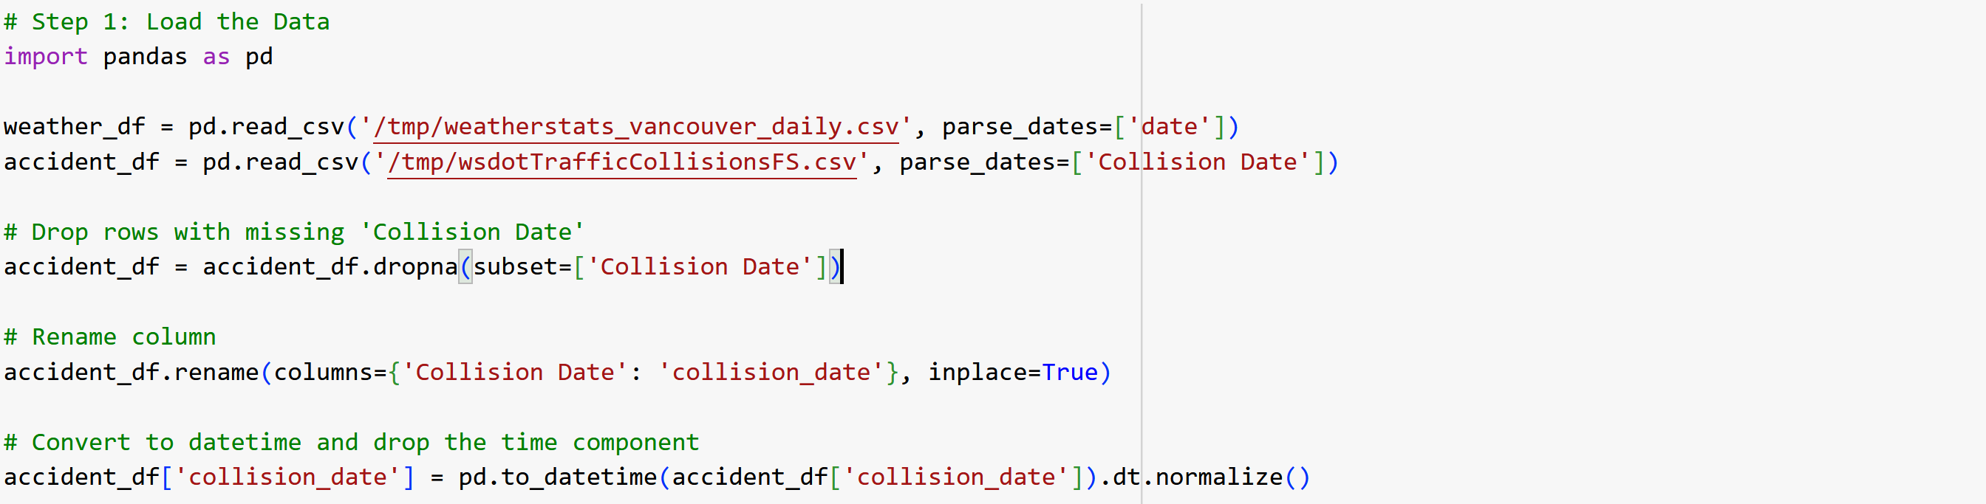
Loading Data, Handling Missing Values, Renaming and Standardizing Columns in Both Datasets
Notes:
--- We carefully identified and treated missing values in both traffic and weather datasets to prevent bias and maintain the integrity of subsequent analyses. Image source: Microsoft 365 content library

Slide 13
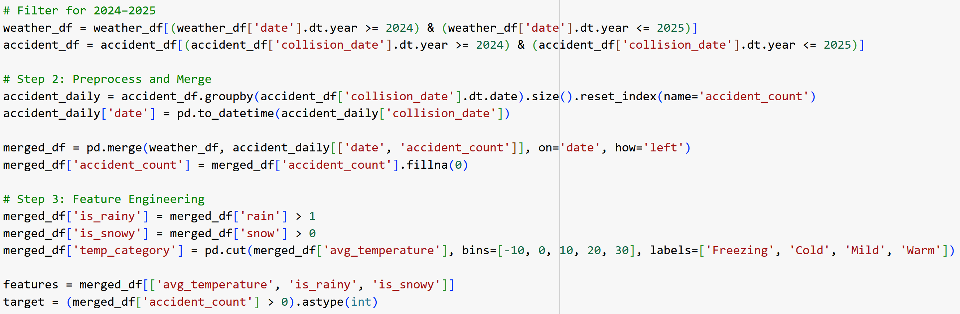
Filtering, Integrating and Aligning Data for Analysis
Notes:
--- The cleaned traffic and weather data were merged and aligned on matching temporal attributes to establish a coherent dataset ready for exploratory and predictive modeling. Image source: Microsoft 365 content library

Slide 14
Exploratory Data Analysis (EDA)
Notes:
EDA techniques were applied to uncover initial insights, detect patterns, and understand distributions in the combined dataset.

Slide 15
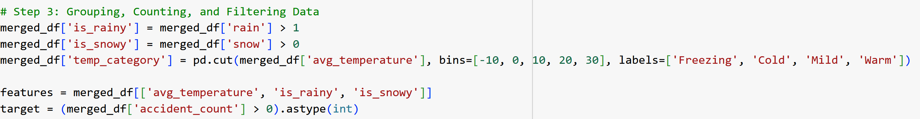
Grouping, Counting, and Filtering Data
Notes:
--- Data was grouped by relevant categories such as date and weather condition, with counts and filters applied to isolate significant trends and anomalies. Image source: Microsoft 365 content library

Slide 16
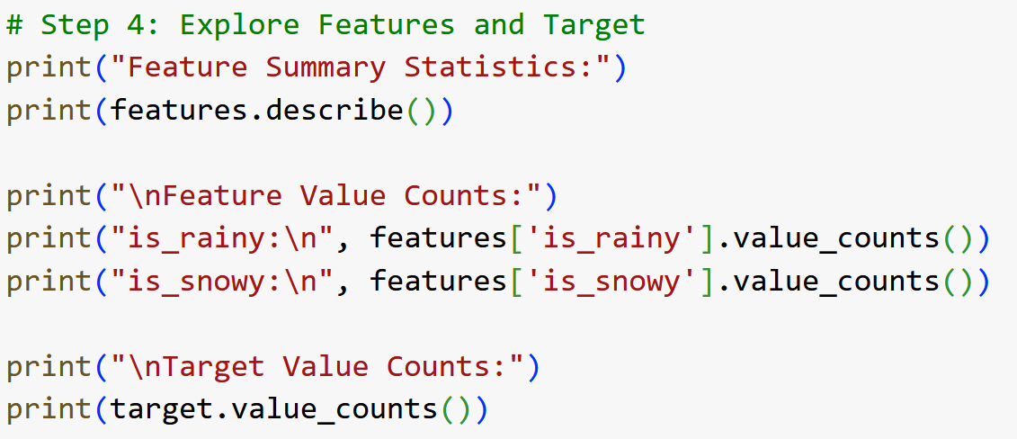
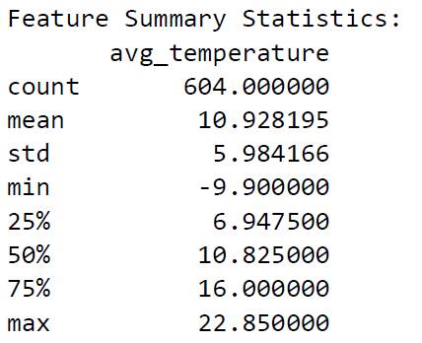
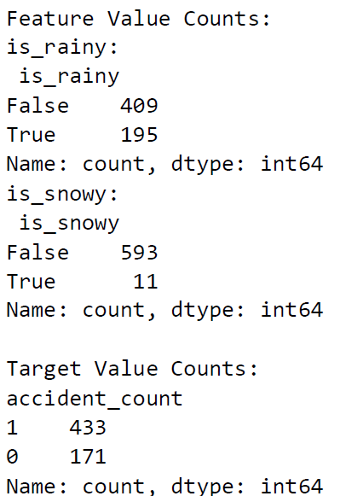
Generating Summary Statistics
Descriptive Statistics Overview
Summary statistics provide key insights into data variables such as accident counts, temperature, and precipitation.
Data Characteristics Insight
These statistics offer a foundational understanding of data patterns and variability for analysis.
Notes:
--- Descriptive statistics summarized key variables like accident counts, temperature, and precipitation, offering a foundational understanding of data characteristics. Image source: Microsoft 365 content library

Slide 17
Visualizing Key Trends in Weather and Traffic Accidents
Notes:
Visualization helped to clearly communicate observed trends and relationships between weather variables and traffic accidents.

Slide 18
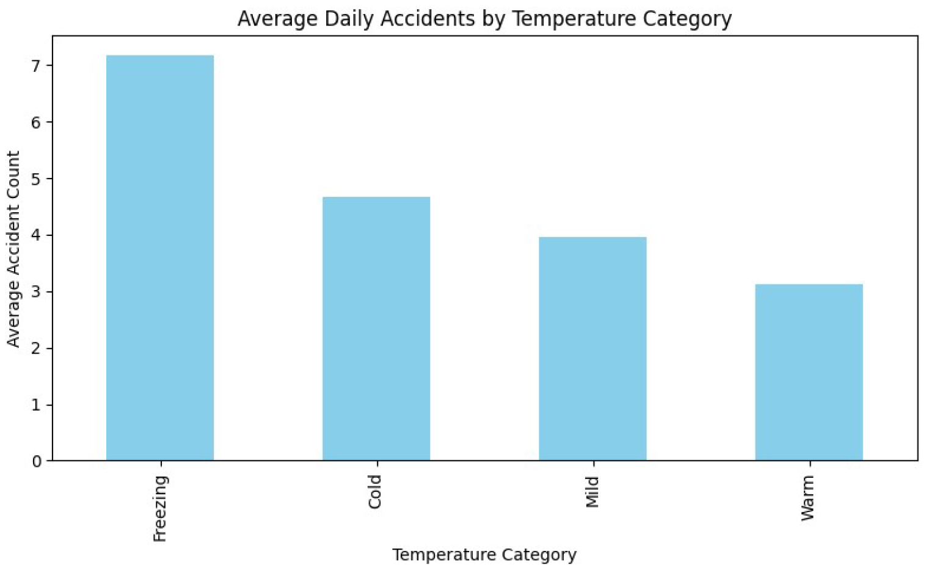
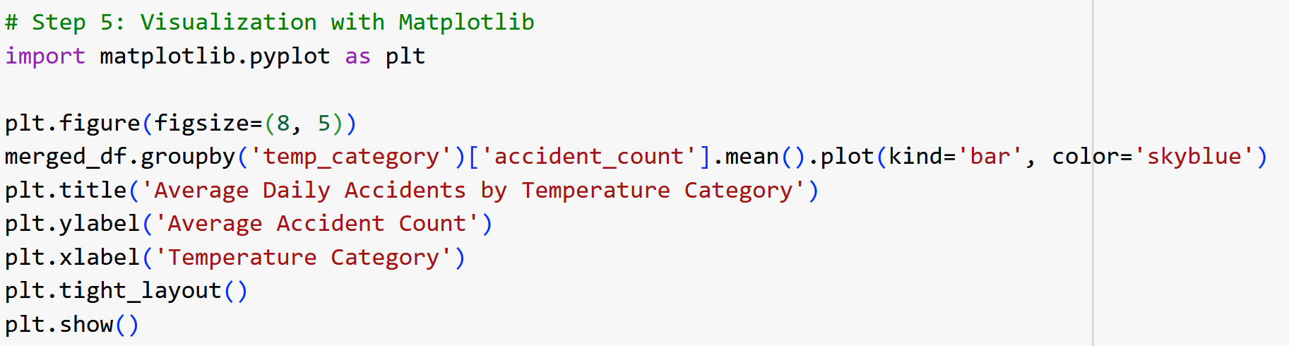
Creating Bar Charts to Show Accident Counts
Purpose of Bar Charts
Bar charts visually represent accident frequencies for different weather conditions, making data easier to interpret.
Notes:
--- Bar charts were created to effectively display the frequency of accidents across different weather conditions, enhancing interpretability. Image source: Microsoft 365 content library

Slide 19
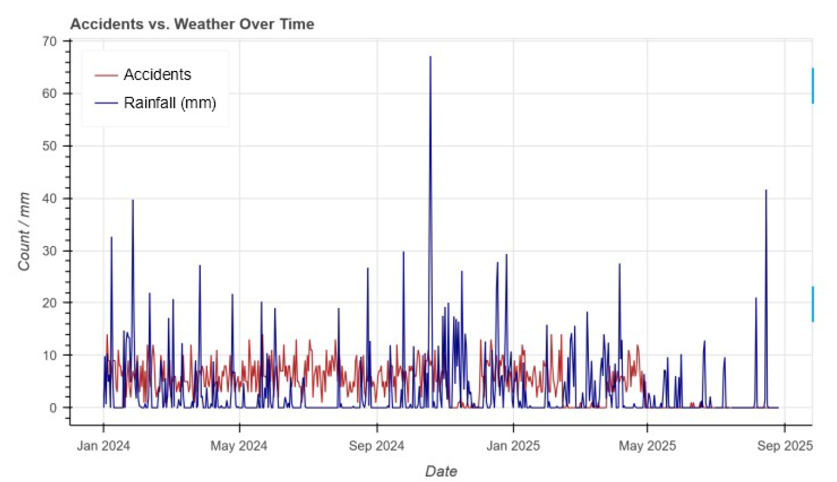
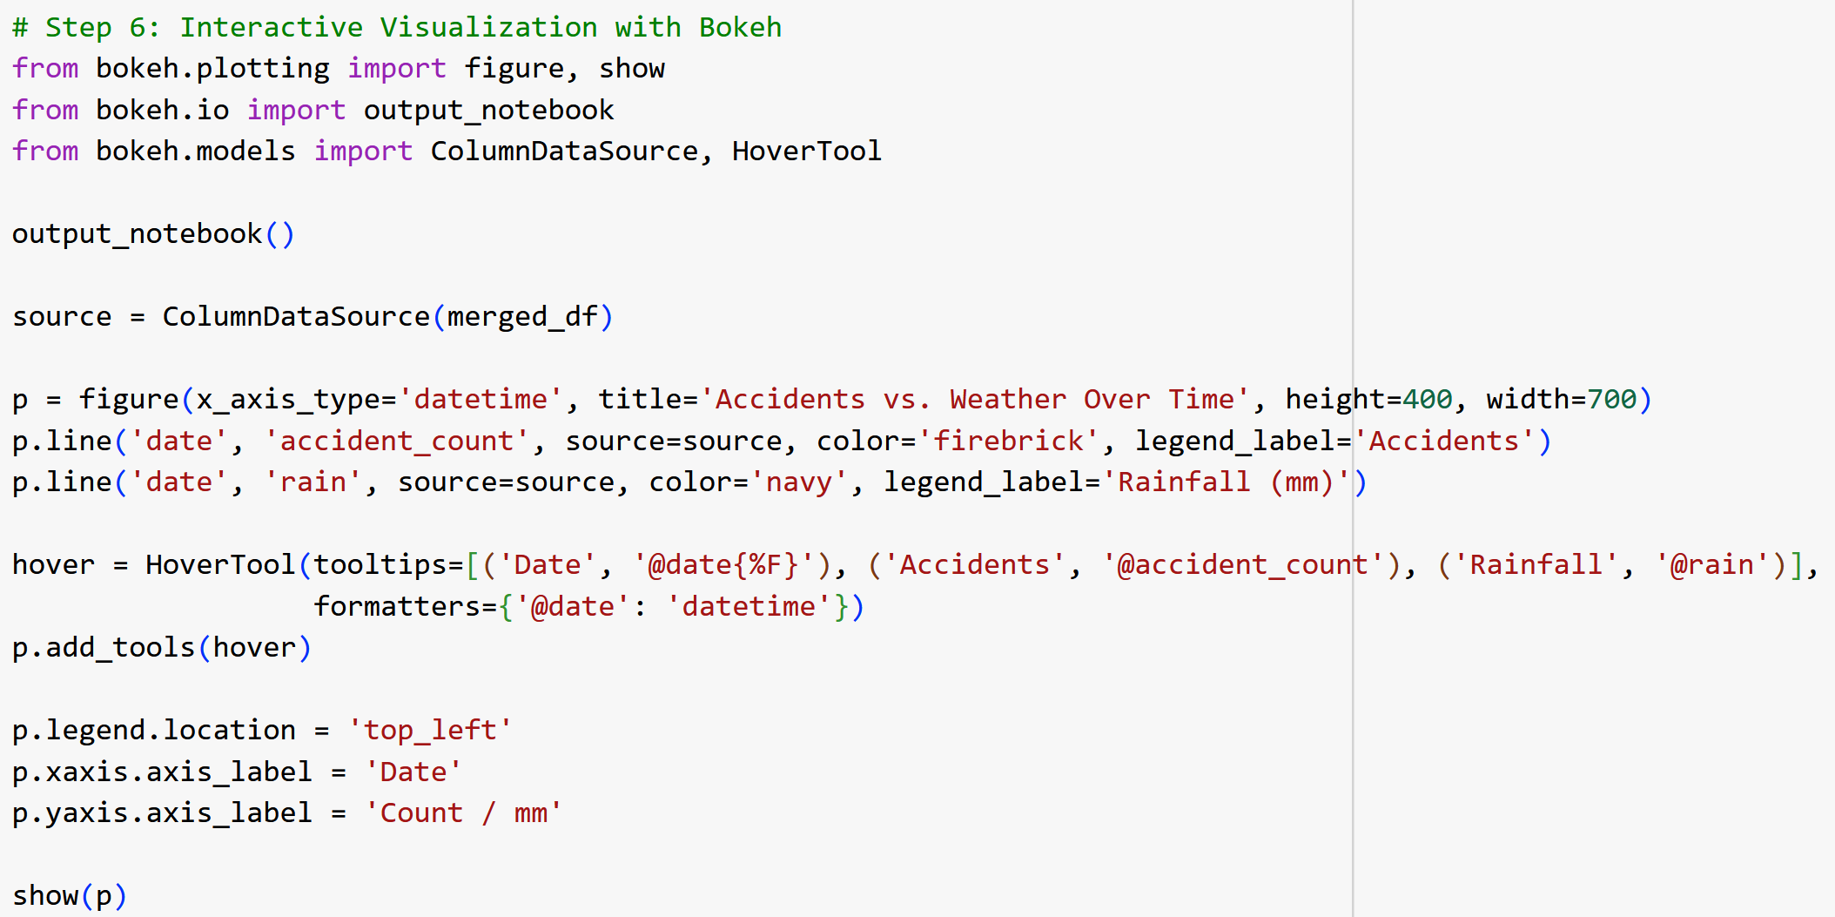
Using Bokeh for Interactive Visualizations
Dynamic Data Exploration
Bokeh enables users to explore data interactively through dynamic plots for better understanding.
Notes:
--- Interactive plots developed with Bokeh allowed dynamic exploration of data, enabling users to drill down into specific dates and weather conditions for deeper insights. Image source: Microsoft 365 content library

Slide 20
Train/Test Split and Machine Learning Modeling
Notes:
To predict accident occurrences based on weather, data was prepared and machine learning models were applied and evaluated.

Slide 21
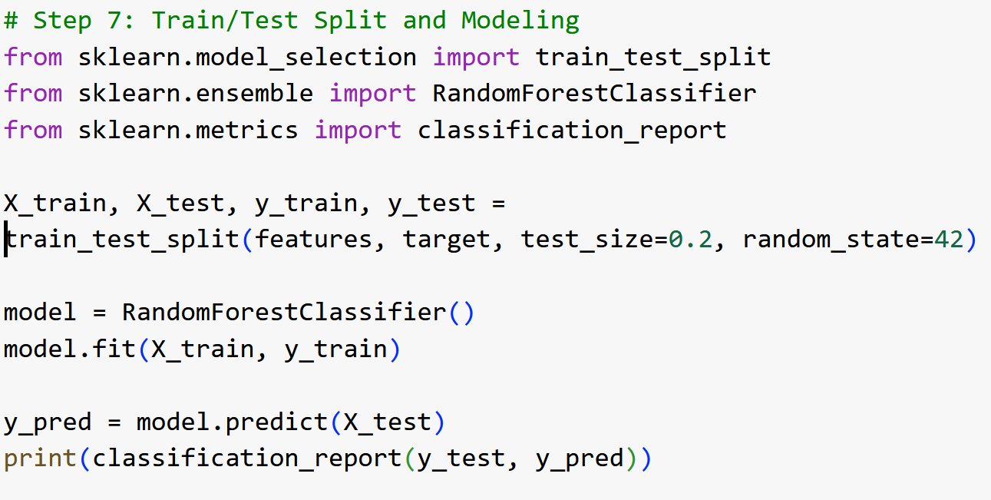
Preparing Data for Model Training and Testing
Data Splitting Importance
Splitting data into training and testing subsets prevents overfitting and allows unbiased model performance evaluation.
The training subset is used to teach the model patterns and relationships within the data.
The testing subset assesses the model's predictive performance on unseen data to gauge generalization.
RandomForestClassifier Usage
Utilized RandomForestClassifier from Sklearn for classifying accident likelihood based on weather conditions.
Benefits of Random Forest
RandomForestClassifier offers robustness and accuracy in handling complex weather data for prediction.
Notes:
--- The dataset was split into training and testing subsets to ensure unbiased evaluation of the machine learning model’s predictive performance. Image source: Microsoft 365 content library

Slide 22
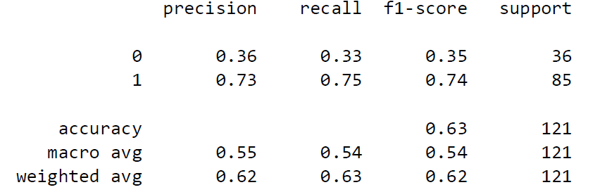
Evaluating Model Performance and Results
Accuracy Metric
Accuracy measures the overall correctness of the predictive model by comparing true results to total predictions.
Precision Metric
Precision indicates how many of the positive predictions made by the model are actually correct.
Recall Metric
Recall assesses the model’s ability to identify all relevant positive cases in the dataset.
Notes:
--- Model performance metrics such as accuracy, precision, and recall were assessed to determine the effectiveness of the predictive model for real-world application. Image source: Microsoft 365 content library

Slide 23
Insights and Conclusions From the Analysis
Notes:
This final section summarizes the key findings, highlighting important correlations and their implications for traffic safety and urban planning.

Slide 24

Temperature’s Stronger Relationship to Accident Rates than Rain
Temperature and Accident Correlation
Temperature changes have a stronger impact on accident rates compared to rain, indicating a critical traffic safety factor.
Rainfall and Accident Correlation
Precipitation shows a lower correlation with accident rates than temperature, highlighting temperature's greater influence.
Notes:
--- The analysis revealed that temperature variations showed a more significant correlation with accident rates than precipitation, suggesting temperature as a critical factor in traffic safety assessments. Image source: Microsoft 365 content library

Slide 25

Key Findings From Model Interpretation
Weather Impact on Accidents
Key weather features significantly affect the likelihood of accidents, highlighting critical environmental factors.
Actionable Insights
Insights from model interpretation help city officials and planners enhance safety measures and reduce accidents.
Notes:
--- Model interpretation identified important weather features influencing accident likelihood, providing actionable insights for city officials and planners. Image source: Microsoft 365 content library

Slide 26
Implications for City Planning and Future Research
Targeted Safety Interventions
Implementing focused measures can effectively reduce urban accidents and improve public safety.
Expanding Research Scope
Future studies can include more diverse data sources for comprehensive urban safety analysis.
Model Refinement for Prediction
Improving predictive models helps forecast accidents and supports proactive city planning.
Notes:
--- Findings can inform targeted interventions to reduce accidents, and future research can expand the scope by incorporating additional data and refining models for better predictions. Image source: Microsoft 365 content library

Slide 27
Conclusion
Data Integration
Combining open data with data science tools allowed detailed analysis of traffic accidents influenced by weather conditions.
Impact on Traffic Accidents
The study revealed how various weather factors affect the frequency and severity of traffic accidents in Vancouver.
Safety and Planning Implications
Insights from the analysis support enhanced safety measures and more informed urban traffic planning decisions.
Notes:
In conclusion, integrating open data and data science tools enabled a comprehensive analysis of how weather impacts traffic accidents in Vancouver. The insights gained pave the way for improved safety measures and informed urban planning.

